Slide 1
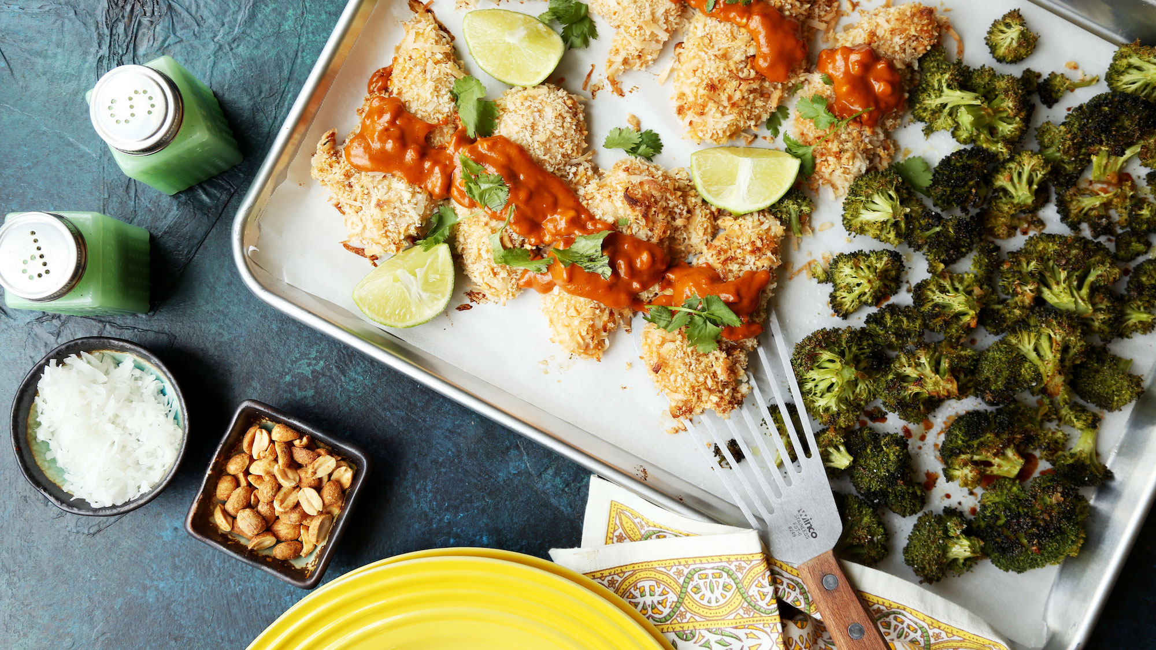


INGREDIENT RECOMMENDATION
Recommendation Tools – MBD 2023

Slide 2




THE RECOMMENDERS
Maria
Karakoulian
Arun
Karthikeyan
Shashank
Gollapalli
Shivaprakash
Mallappa

Slide 3


THE PROJECT BACKGROUND
Promoting healthy recipes and ingredients
The Business Objective
Building a recommender system that:
Recommends ingredients to users based on their past recipe reviews
Recommends healthier alternative ingredients to users based on the nutritional values
The Data Science Objective

Slide 4



THE BUSINESS INSIGHTS
165,226
Reviews
11,346
Users
231,637
Recipes
14.5
Average Number of Reviews per User
2.6
Average Number of Reviews per Recipe
5.5
Average Rating per User

Slide 5
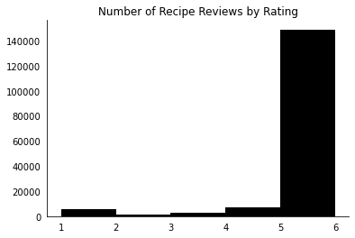
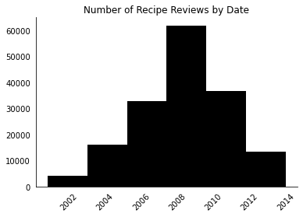
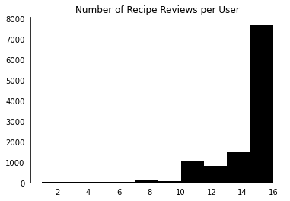
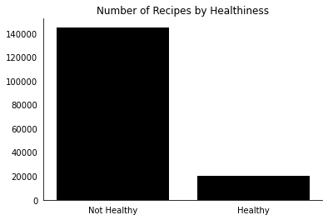
THE BUSINESS INSIGHTS
The dataset is largely imbalanced with most of the reviews having a rating of 6 and most of the recipes being unhealthy

Slide 6
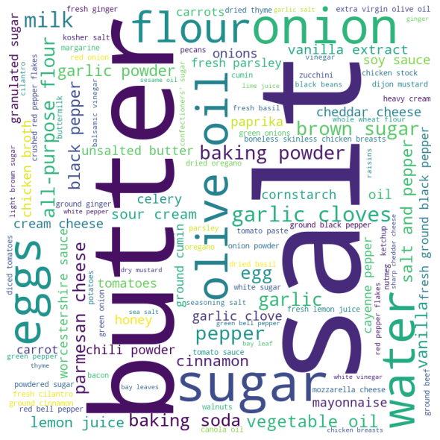
THE BUSINESS INSIGHTS
The most used ingredients in the recipes are:
butter, salt, sugar, flour, eggs, olive oil

Slide 7
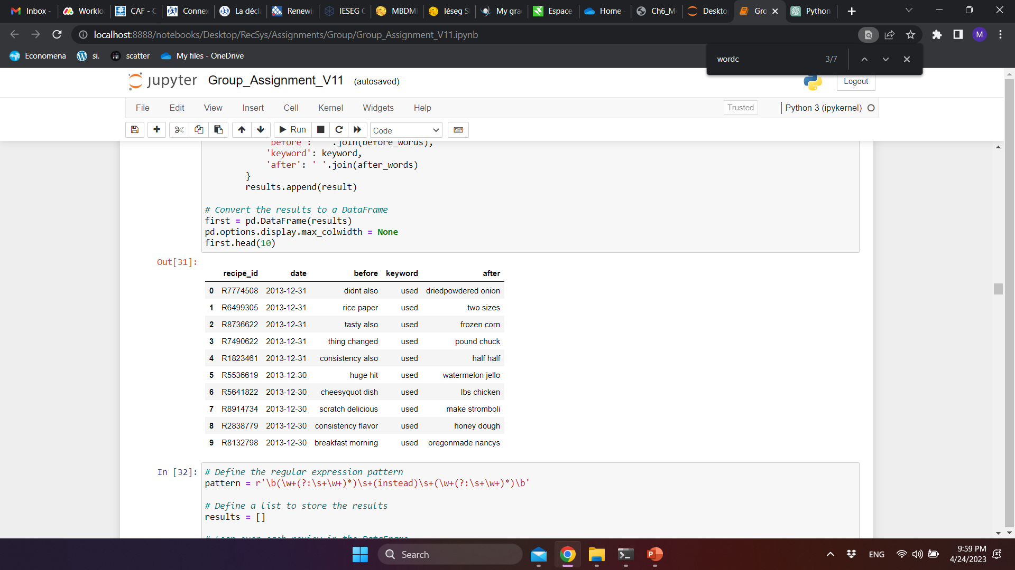
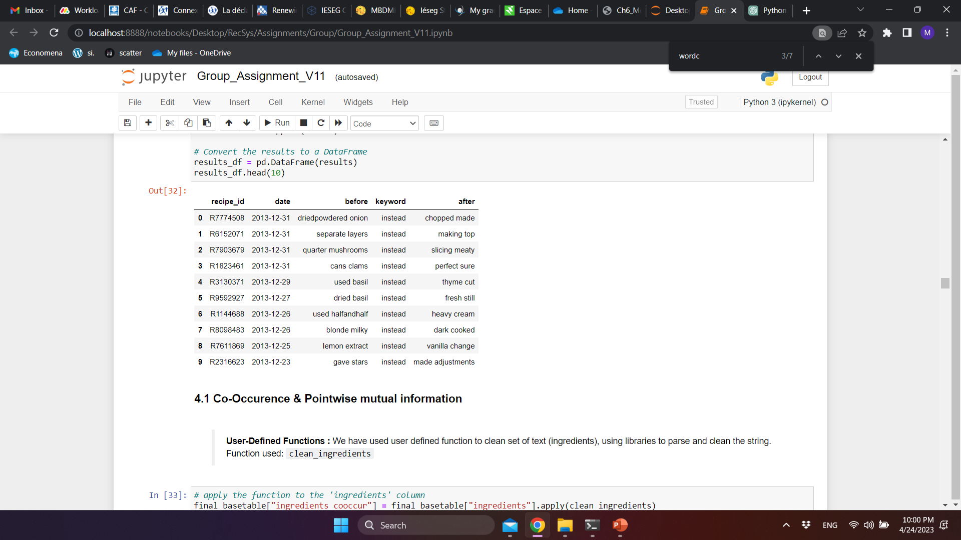
THE BUSINESS INSIGHTS
Ingredient Substitution
Users have their own preference when it comes to ingredients, so they have replaced them to their taste

Slide 8
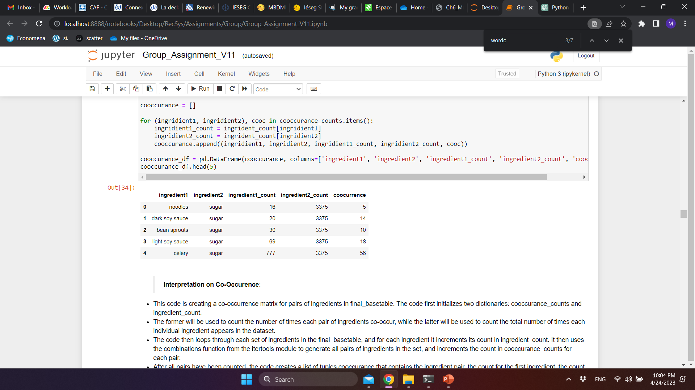
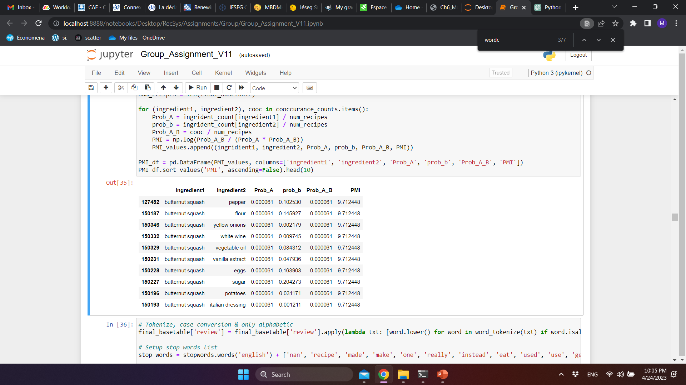
THE BUSINESS INSIGHTS
Ingredient Co-Occurrence
There are many ingredients that are usually used together

Slide 9
THE METHODOLOGY: BASETABLE CREATION (1/2)
Reviews
Recipes
User ID
Recipe ID
Reviewed Date
Rating
Review
Recipe Name
Recipe ID
Minutes
Contributor ID
Submitted Date
Tags
No. of Steps
Steps
Description
Ingredients
No. of Ingredients
Nutrition
Calories
Fat
Sugar
Sodium
Protein
Sat. Fat
Carbs
Healthy
New variables created
Merged the tables on Recipe ID
Voice: Shashank Gollapalli

Slide 10
THE METHODOLOGY: BASETABLE CREATION (2/2)
Filtering Layers
For the sake of avoiding memory issues, we have further filtered the created table as follows:
Keeping only recipes with 10+ reviews
Keeping only users with 5+ reviews
Sorting the table by date from newest to oldest review
Taking only the most recent 10%
1
2
Final Basetable
Our final basetable has 16,552 observations and 23 variables
Voice: Shashank Gollapalli

Slide 11
xxxx
THE METHODOLOGY: TEXT PROCESSING
Pre-Processing Layers
1
Reviews Analysis
Tokenizing
Removing stopwords
Lemmatizing
Keeping only the tokens that have a length greater than 2
Ingredients Unification
Creating a list of all ingredients
Grouping similar ingredients
Unifying the different variations of each ingredient and replacing them in the basetable
2
Voice: Shashank Gollapalli

Slide 12
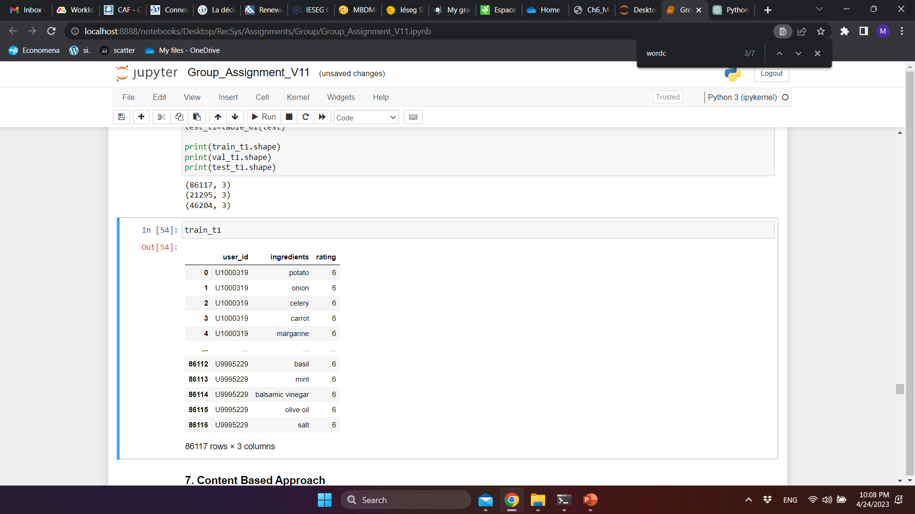
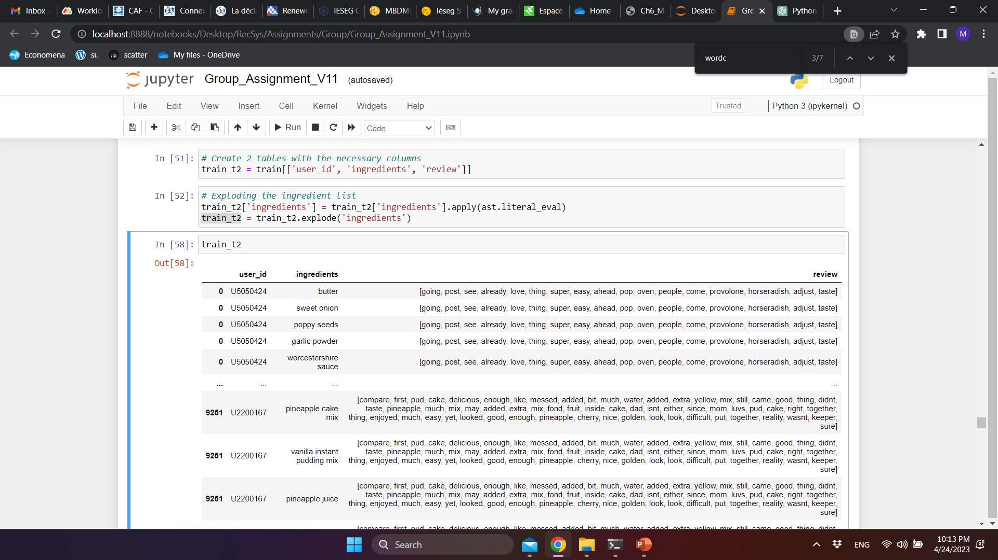
xxxx
THE METHODOLOGY: MODEL BUILDING
Train / Test Split
User Item Rating Table
User Item Review Table
70%
30%
Train
Test
50%
20%
Train
Validation
Content-Based Approach
Collaborative Filtering Approach
Voice: Shashank Gollapalli
Voice: Shashank Gollapalli

Slide 13
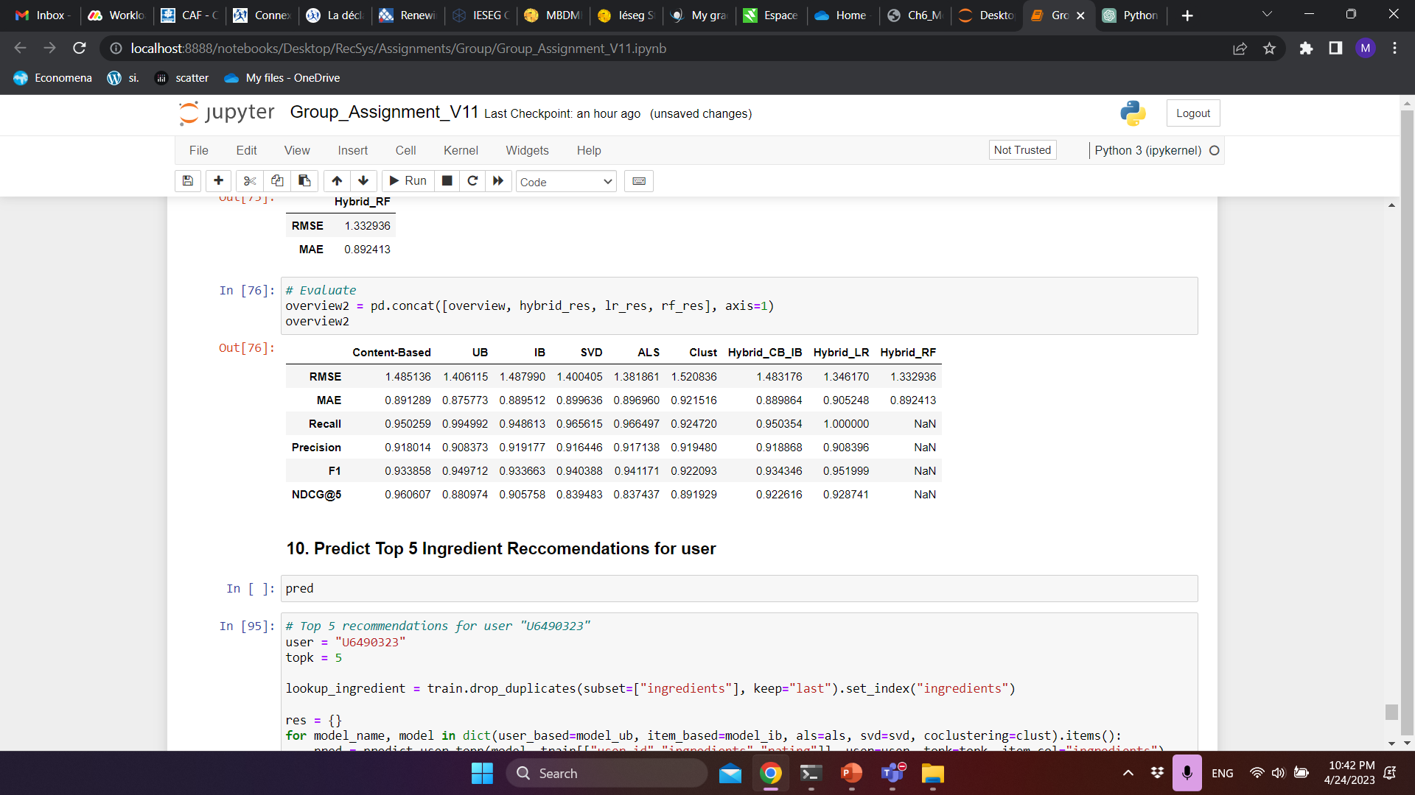
THE RESULTS
Models Evaluation
Voice: Shashank Gollapalli

Slide 14
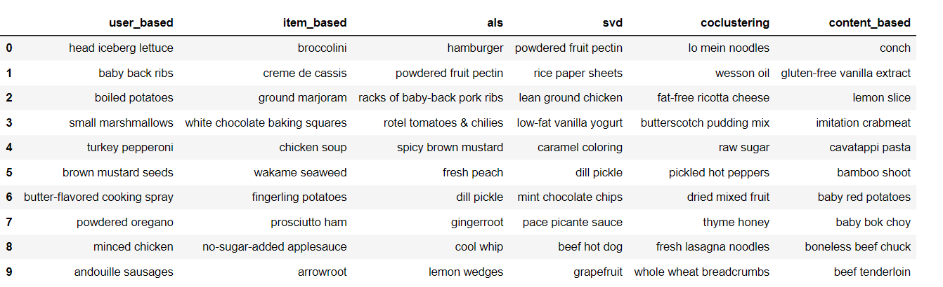
xxxx
THE RESULTS
The Predictions
Top 5 Ingredient Recommendations for U6490323
Voice: Shashank Gollapalli

Slide 15
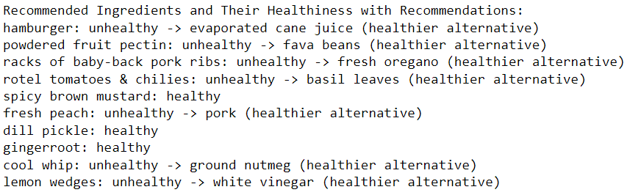
xxxx
THE RESULTS
The Predictions
Top 5 Healthier Alternative Recommendations U6490323
Voice: Shashank Gollapalli

Slide 16
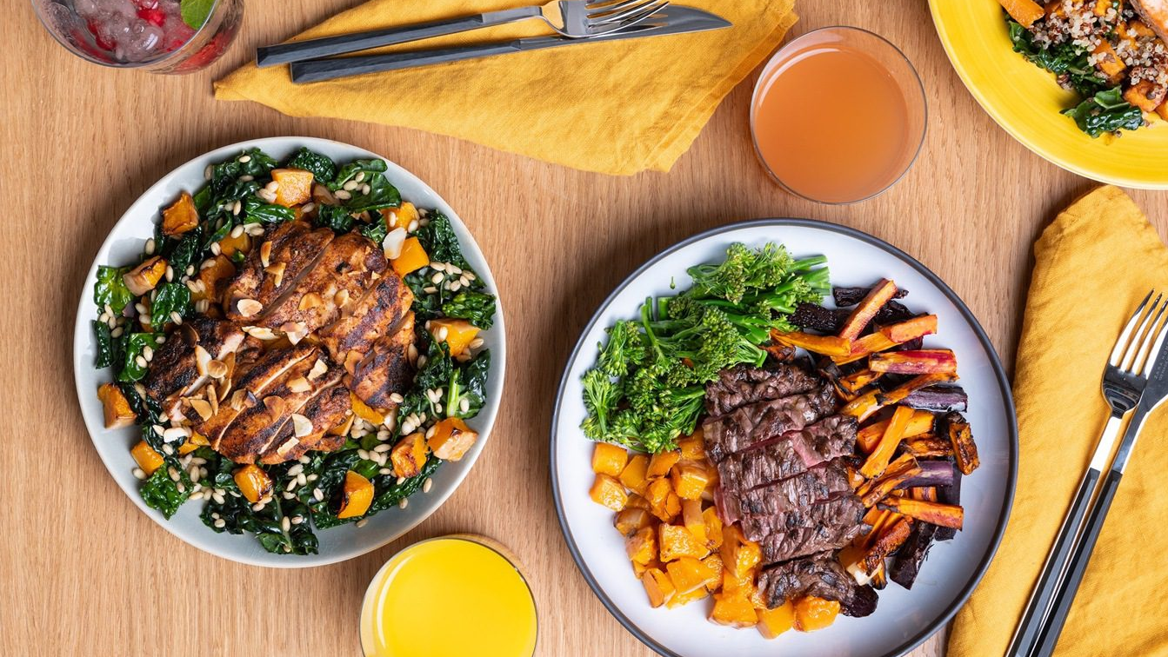
THANK YOU.

